Slide 1
Project 2 Evaluation

Slide 2
Policy
Should run under 2 minutes (test with computers in 326)
Should be correct with any of G++/Clang++/VSC++ (-std=c++11)
Correct for op_test_cnt = (1 << 10): 50%
Correct for op_test_cnt = (1 << 20): 20% `op_test_cnt` is defined under src/I2P2_test.cpp, line 20.
Report: 10%
Rewrite with template & write your own tests: 20% (e.g., oj::Vector<oj::List<double>> vec)

Slide 3
Basic
Tune the variable `op_test_cnt` defined under src/I2P2_test.cpp, line 20. Repeat step 2~5 for G++/Clang++/VSC++:
Compile with the Makefile, make sure there is no warning.
Run the executable.
Make sure it runs under 2 minutes (with the computers in 326).
Make sure no error is displayed during execution.
If all requirements are met, credits will be given according to step 1.

Slide 4
Advanced
Copy the entire project to another folder
Modify so that it complies with STL in terms of generalization: I2P2::List<int>::iterator = std::list<int>::iterator I2P2::Vector<I2P2::Vector<int>> = std::vector<std::vector<int>> But don’t need to add functions not included in the original template.
Pass TAs sample tests - You will earn 20 points here.
Create your own tests This is removed so that your loading is eased. You receive solid 20 points passing the sample test.

Slide 5
Report
Discuss about how you implemented each function
Discuss time complexity
Discuss the hierarchy relationship
The report is to verify your comprehension of this project
You may choose whether to include discussions about the template part

Slide 6
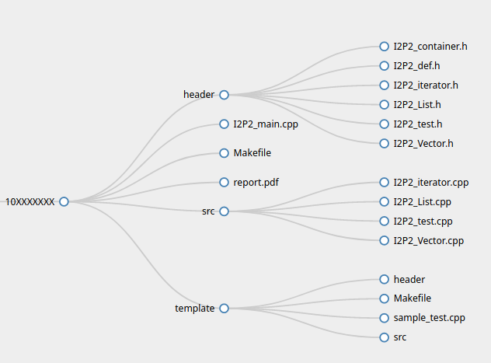
Directory Structure
If you don’t follow this rules, in the worst case you get 0 points
Your directory tree should look like this:
You have the liberty to put whatever in template/header and template/src, as long as your Makefile works (unless you give up on template)

Slide 7
Plagiarism Detection
We will check with a very well-known plagiarism detection tool
If similarity is greater than 20%, you may be consulted individually

